Slide 1
YouTube Data Harvesting and Warehousing using SQL and Streamlit
-Asvanya Vetrivel

Slide 2
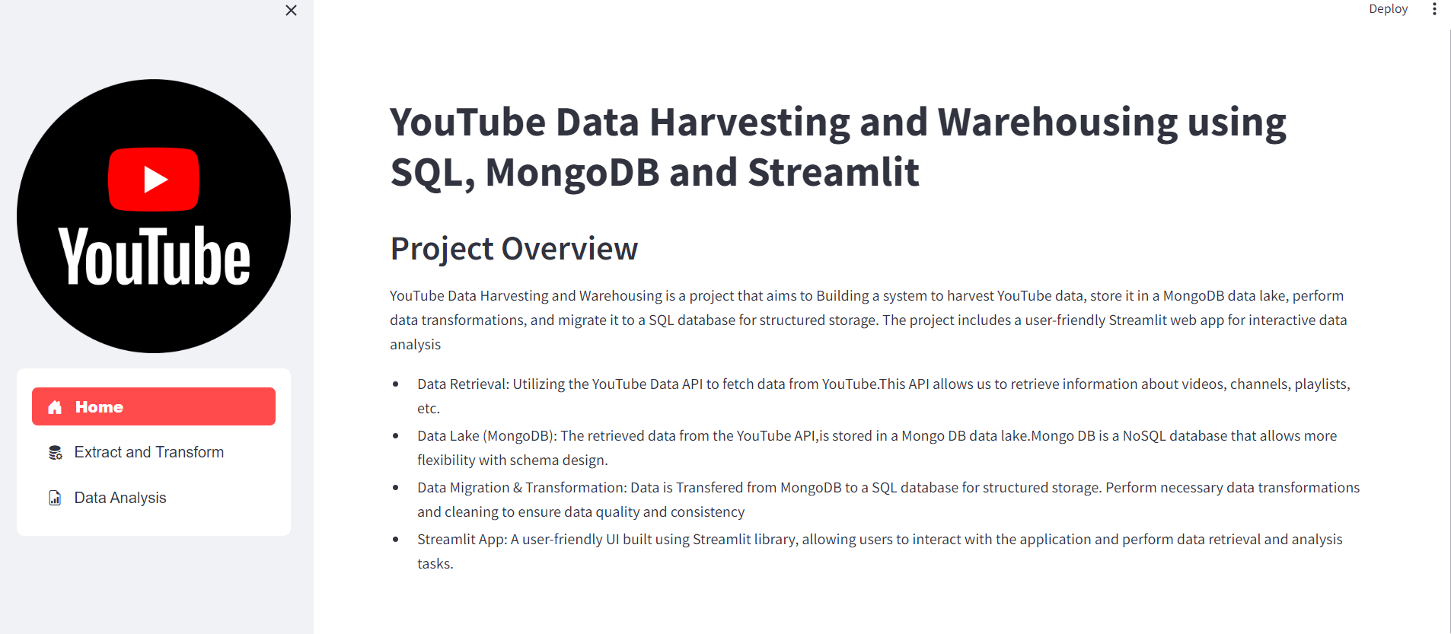
Home page-Streamlit

Slide 3
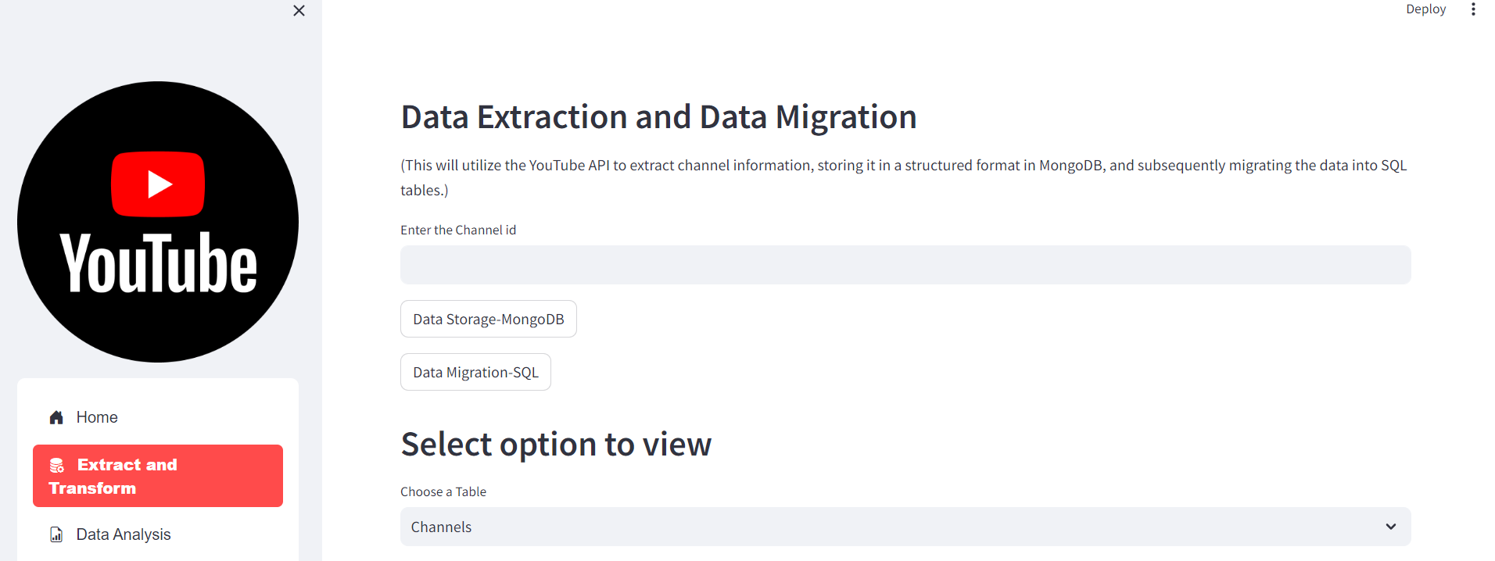
Extract and Transform

Slide 4
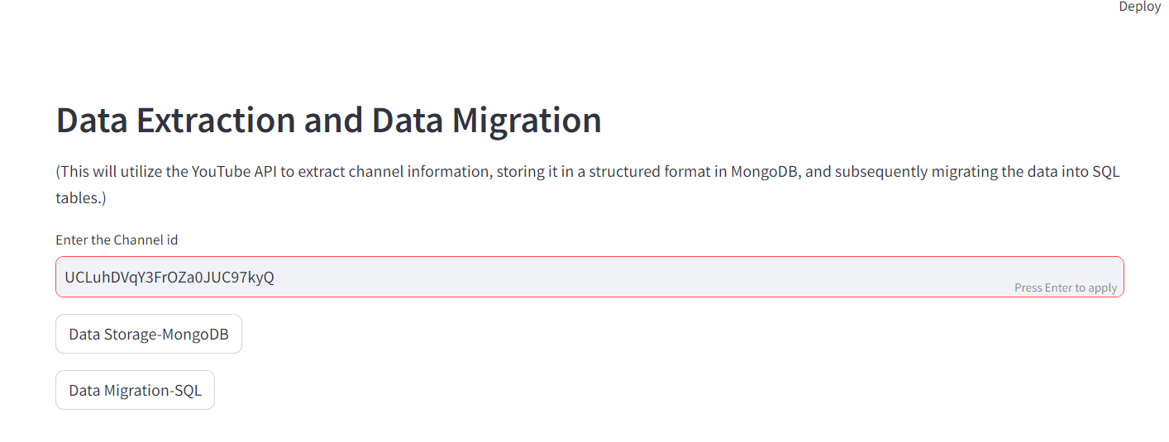
Enter the channel ID from the YouTube channel

Slide 5
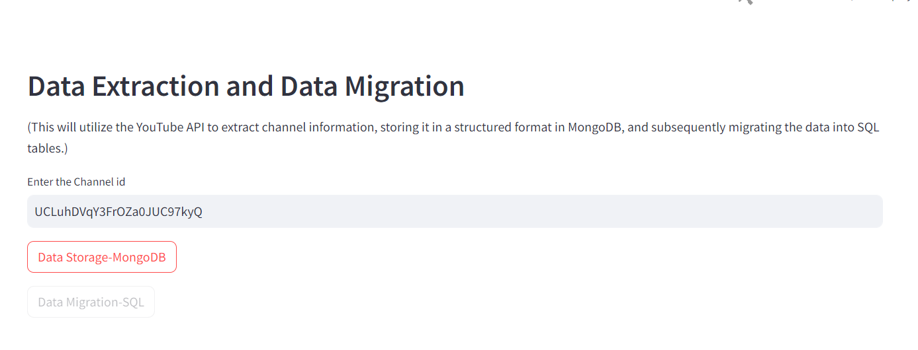
Data Extraction phase-Using the channel id, the YouTube data will be stored in Mongo DB

Slide 6
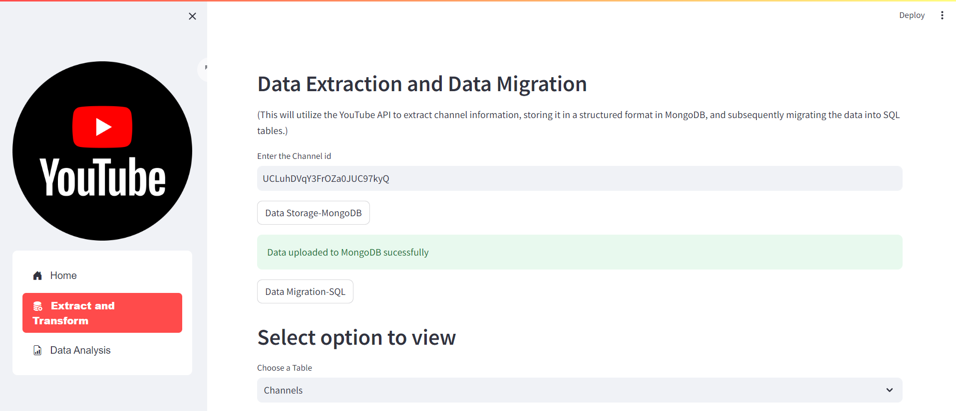
Data Extracted Successfully and stored in Mongo DB

Slide 7
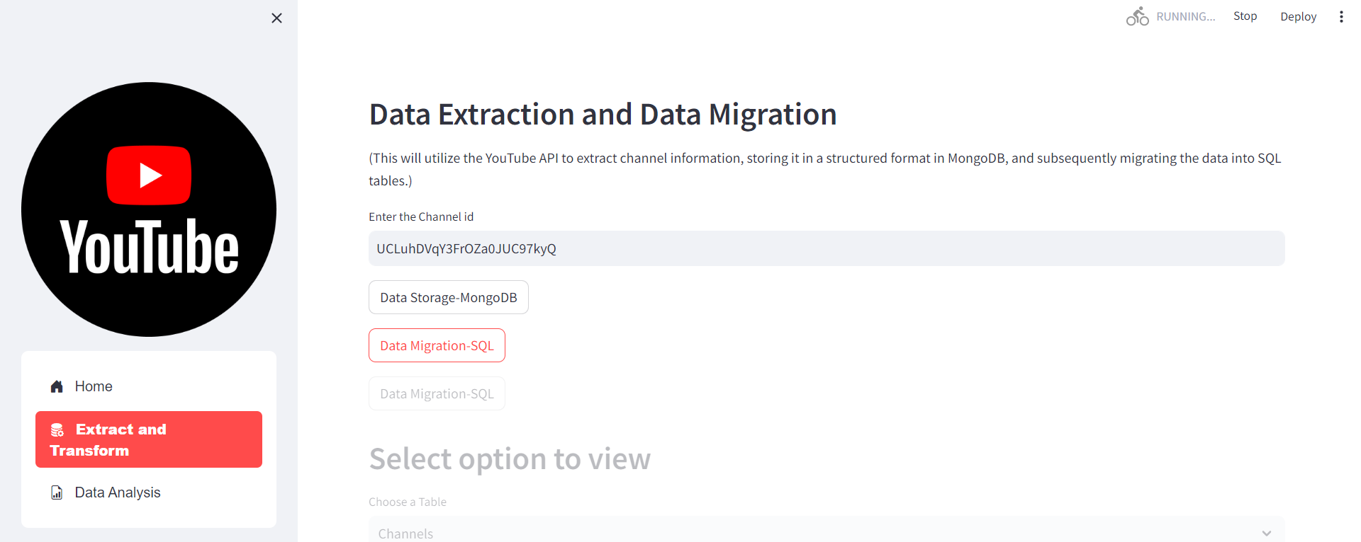
Data Migration Phase

Slide 8
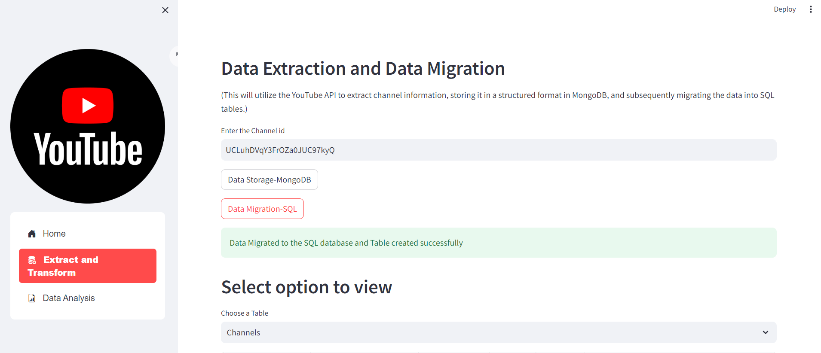
From Mongo DB the data migrated to SQL database and Tables created successfully

Slide 9
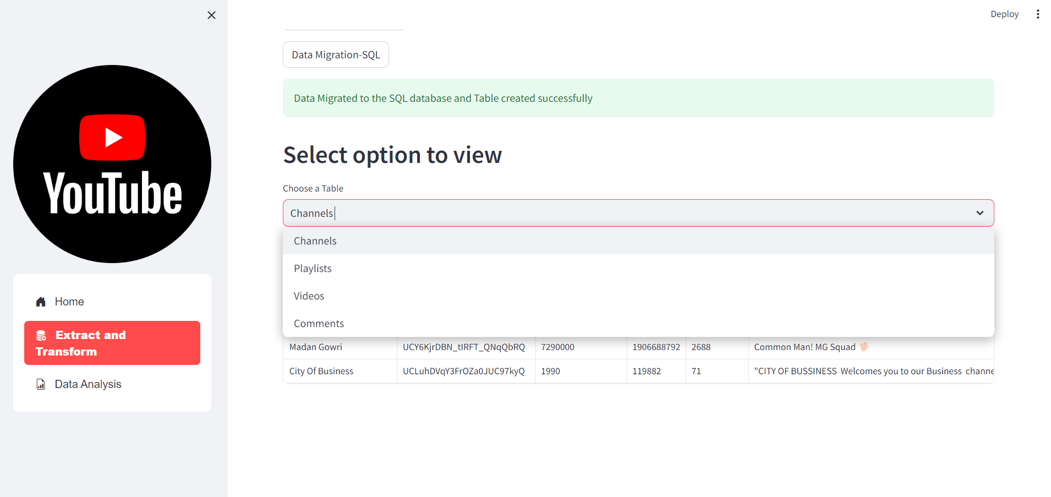
Viewing the Tables-Channels,Playlist,Videos,Comments

Slide 10
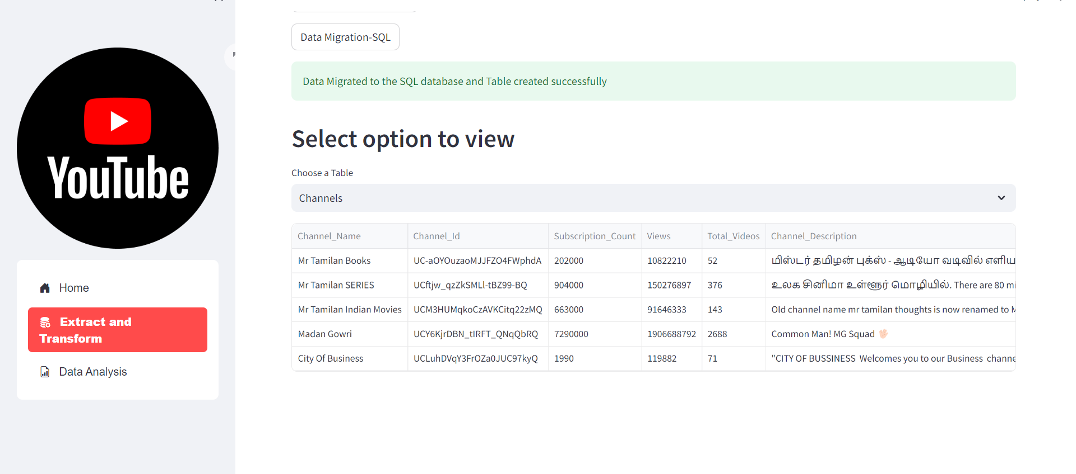
Channel Table

Slide 11
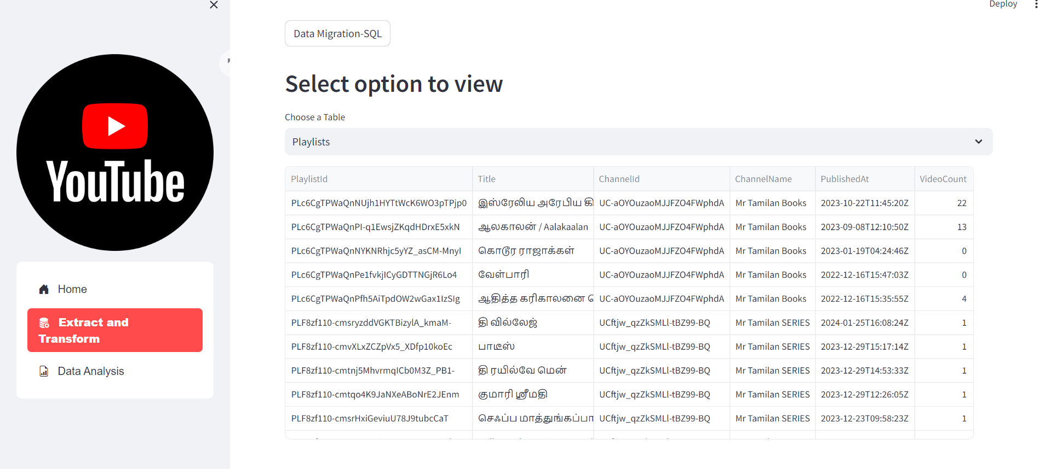
Playlist Table

Slide 12
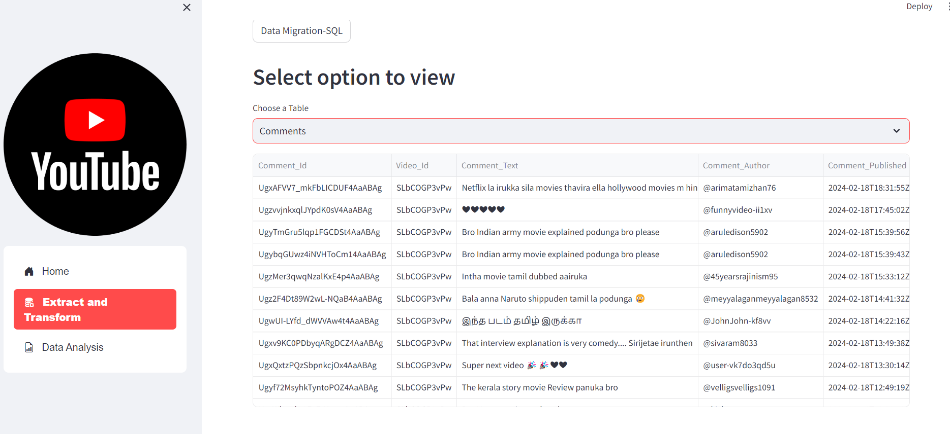
Comments Table

Slide 13
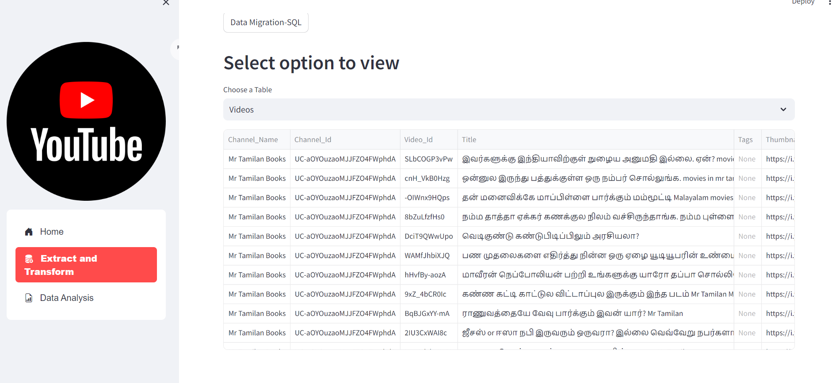
Videos Table

Slide 14
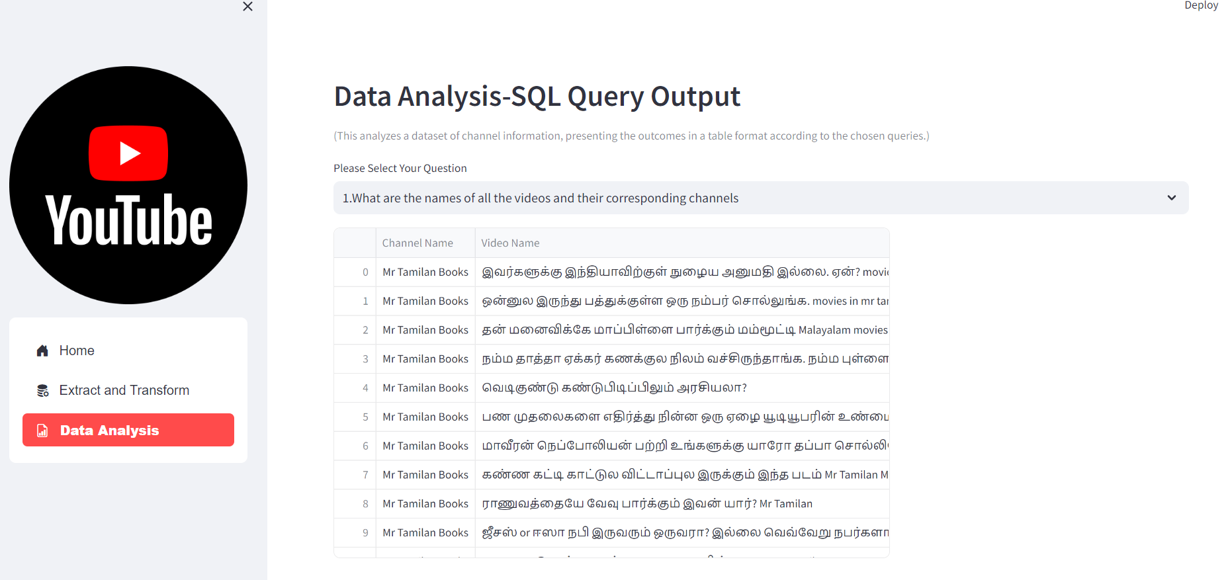
Data Analysis Phase

